Slide 1
Strengthening Nursing Home Emergency Preparedness: Insights from Telligen's Online Assessment Tool and Collaborative Strategies for Building Resilience
Brian Feist, BSN, RN Sr. Quality Improvement Facilitator Telligen QIN-QIO

Slide 2
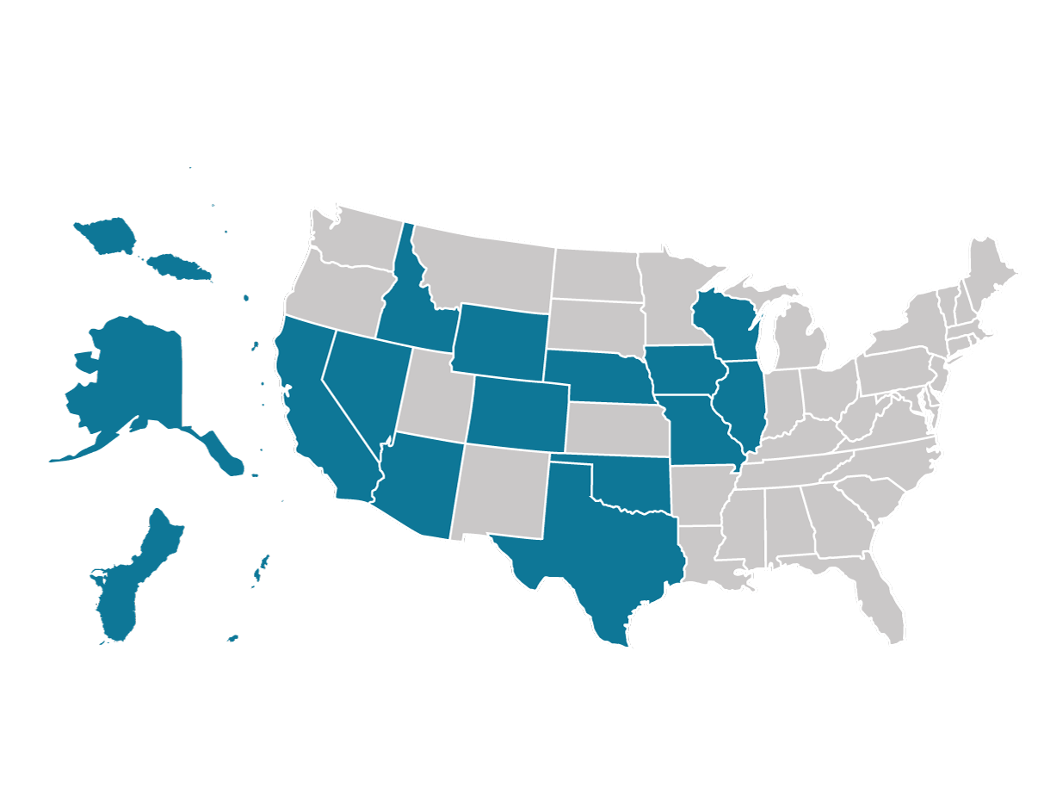
Telligen QIN-QIO and HQIC
Telligen is a Centers for Medicare & Medicaid Services (CMS) Quality Innovation Network-Quality Improvement Organization (QIN-QIO) for Colorado, Illinois, Iowa and Oklahoma and a Hospital Quality Improvement Contractor (HQIC) covering 15 states and American Samoa.

Slide 3
Ice Breaker Questions
What is your comfort level with emergency preparedness planning?
What is one element of a comprehensive emergency preparedness plan?

Slide 4
Session Objectives
Participants will be able to:
Recognize the value of a gap analysis to assess emergency preparedness plans and for system-level improvement
Describe the challenges and barriers faced by nursing homes in preparing for public health emergencies and natural and man-made disasters
Discover best practices to foster a culture of readiness and resilience during an emergency

Slide 5
Introduction
Natural and man-made disasters and public health emergencies, such as the recent COVID-19 pandemic, have significantly impacted nursing homes, highlighting the critical need to address underlying challenges in emergency preparedness
These challenges significantly hinder the ability of nursing homes to effectively respond to emergencies, jeopardizing the safety and well-being of residents and staff members

Slide 6
Nursing Home Emergency Preparedness Regulations
§ 483.73 Emergency Preparedness
The LTC facility must establish and maintain an emergency preparedness program that meets the requirements of this section. The emergency preparedness program must include, but not be limited to, the following elements:

Slide 7
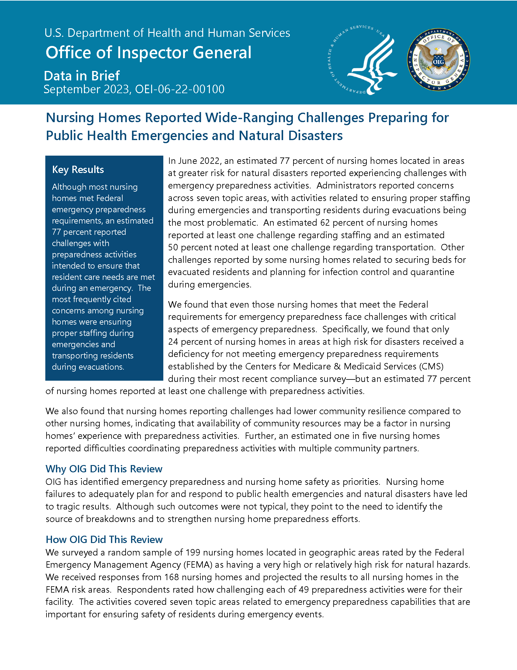
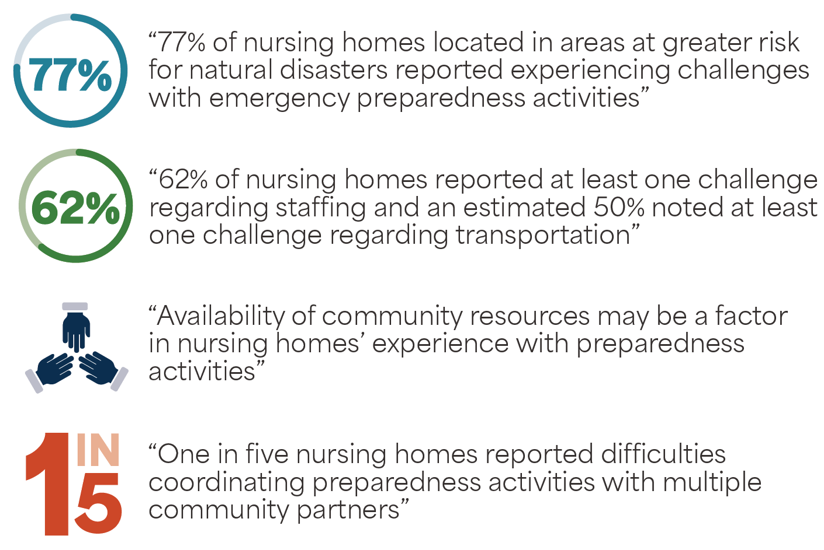
September 2023 OIG Report: Call to Action
https://oig.hhs.gov/oei/reports/OEI-06-22-00100.pdf

Slide 8
Telligen’s Emergency Preparedness Plan (EPP) Assessment
Overview and background:
Standardized review of EPPs and decreased unexplained variation in the plans
Co-designed with nursing home leaders, trade associations, and health departments
Serves as a gap analysis and provides a comprehensive checklist
After completion, nursing homes receive an automated email with targeted resources to strengthen gaps that were identified in their plan
Telligen created a dashboard of results, to engage corporate leadership
Incorporated completion of the assessment into our B.E.S.T. in Class award

Slide 9
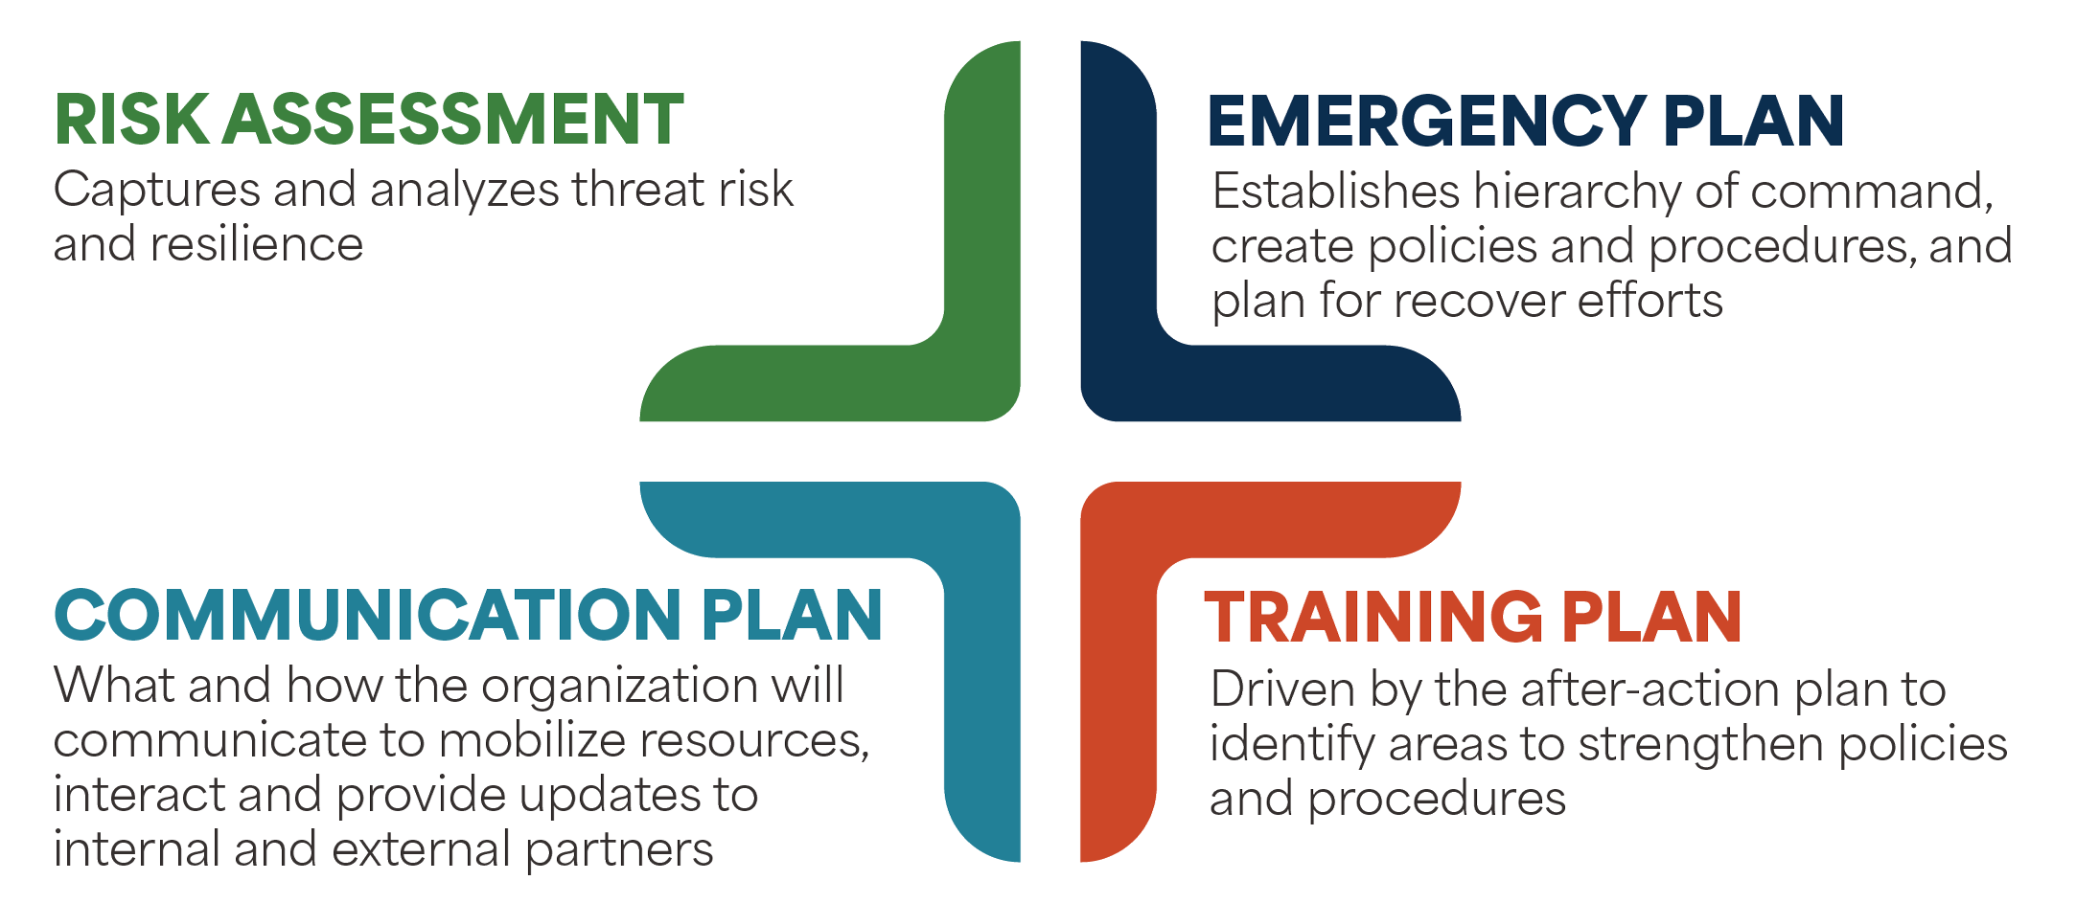
Telligen’s EPP Assessment Elements

Slide 10
Engagement Strategy
To engage corporate leadership, Telligen created a gap analysis summary report that identifies trends and areas of concern across the system

Slide 11
Engagement Strategy (cont.)
In 2023, the B.E.S.T. in Class recognition award was introduced. It challenged participants to:
Sustain robust infection prevention practices and training
Complete a gap analysis for their emergency preparedness plans
Receive the Blue Ribbon in COVID-19 Vigilance award for three quarters
Meet the criteria for preventable emergency department visits

Slide 12
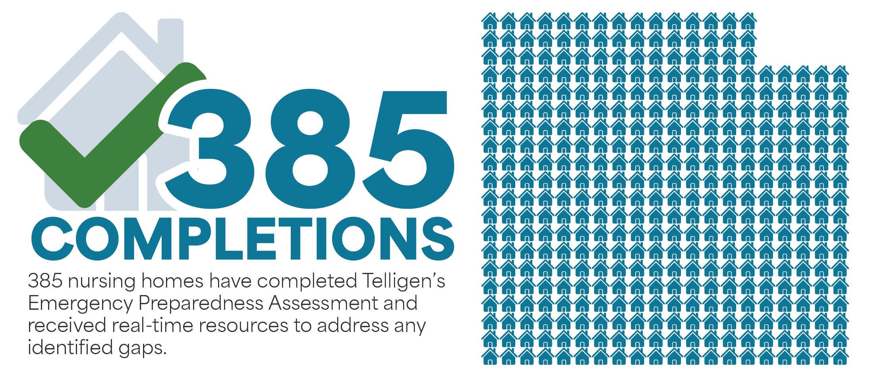
Impact: Completions as of February 9, 2024

Slide 13
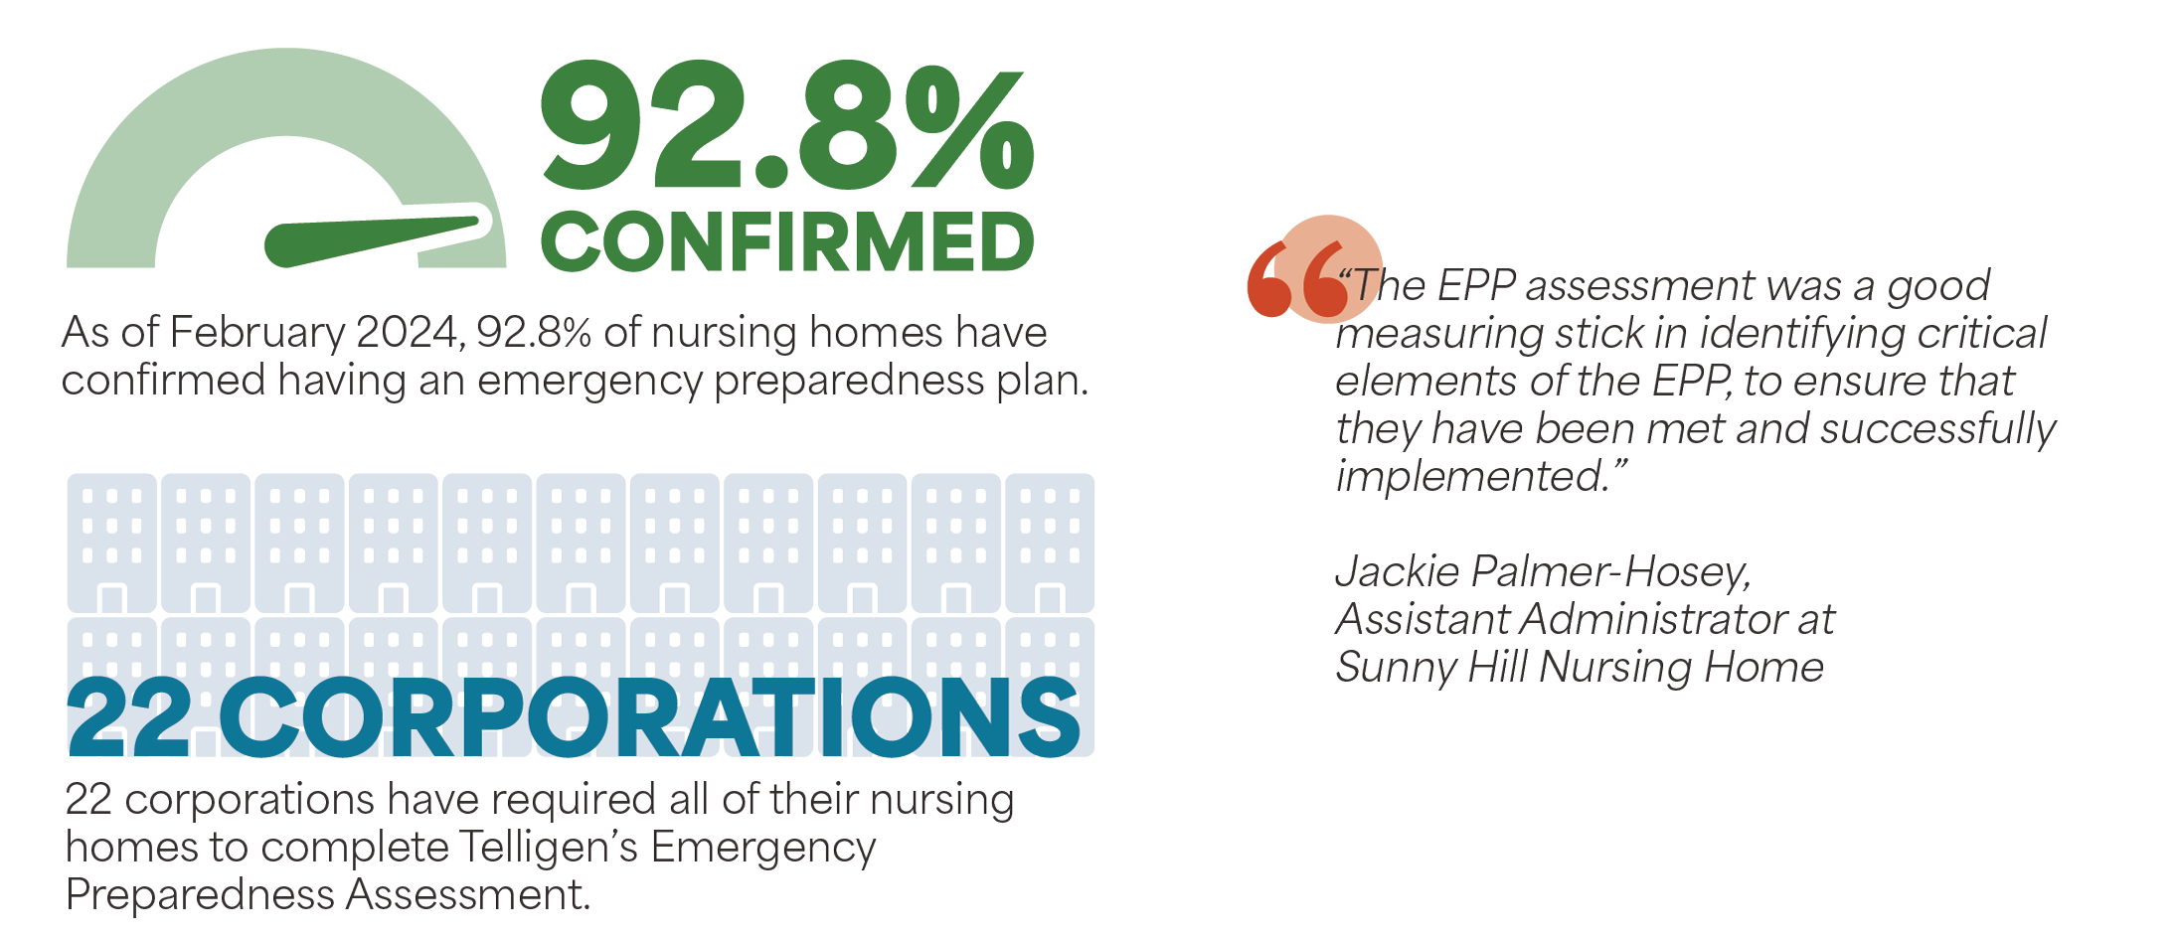
Impact

Slide 14
Assessment Results
Training Plan: 84%
Emergency Plan: 86%
Goal: 100%
Compliance
Testing Plan: 89%
Communication Plan: 92%
Risk Assessment: 96%

Slide 15
Emergency Preparedness Survey Tags
Tags included in data:
Testing and Training: E0036, E0037, E0039
Plan, Policy and Program: E0001, E0006, E0004, E0013, E0020, E0022, E0023, E0024
Communication: E0029, E0030, E0031, E0032, E0033, E0035
Subsistence Needs: E0015
Emergency Power: E0041
Testing & Training: 341
Plan, Policy & Program: 315
Communication: 152
Subsistence Needs: 83
Emergency Power: 71

Slide 16
Emergency Preparedness Enhanced Technical Assistance (TA)

Slide 17
Technical Assistance: Training
Assess existing training and collaborate with nursing homes to fill gaps
Complement nursing homes’ training infrastructure
Identify opportunities to enhance training on existing policies and procedures
Establish a cadence of regular training schedule
Provide best practices to secure leadership support and buy in

Slide 18
Technical Assistance: Exercises & Drills
Our 1:1 customized TA includes asking the nursing home to:
Pick the top 3-5 threats from the Hazard Vulnerability Assessment for focused tabletop exercises
Challenge – choose different drills each time
Select the policy & procedure you want to emphasize during these events
Communication plan, evacuation plan and/or shelter in place plan
Set objectives and identify factors for success – establish what you hope to achieve
Identify an evaluator role to observe and report back findings

Slide 19
Technical Assistance: After Action Review
Provide the nursing home with guidance to complete the following:
Hot wash: an immediate debrief to ask three questions
What went well? What didn’t go well? Why didn’t it go well?
Complete the after-action and improvement plan with best practices and training schedule
Secure leadership engagement and input
Process to report information back out to everyone involved

Slide 20
Technical Assistance: Convening Community Partners
Utilizing our LEAD! LOA expertise, we partner with nursing homes to:
Build local relationships for resiliency
Understand local organizations – players, resources, assets, goals
Participate in community connection points – coalition meetings, local networking events
Use public narrative to share stories as a strategy to feel connected and motivate people to action
Conduct 1:1s to make specific requests and offers
Engage in follow-through and follow-up to ensure strong relationships

Slide 21
“Plans are nothing; planning is everything.”
- Dwight David Eisenhower
This Photo by Unknown Author is licensed under CC BY-NC

Slide 22
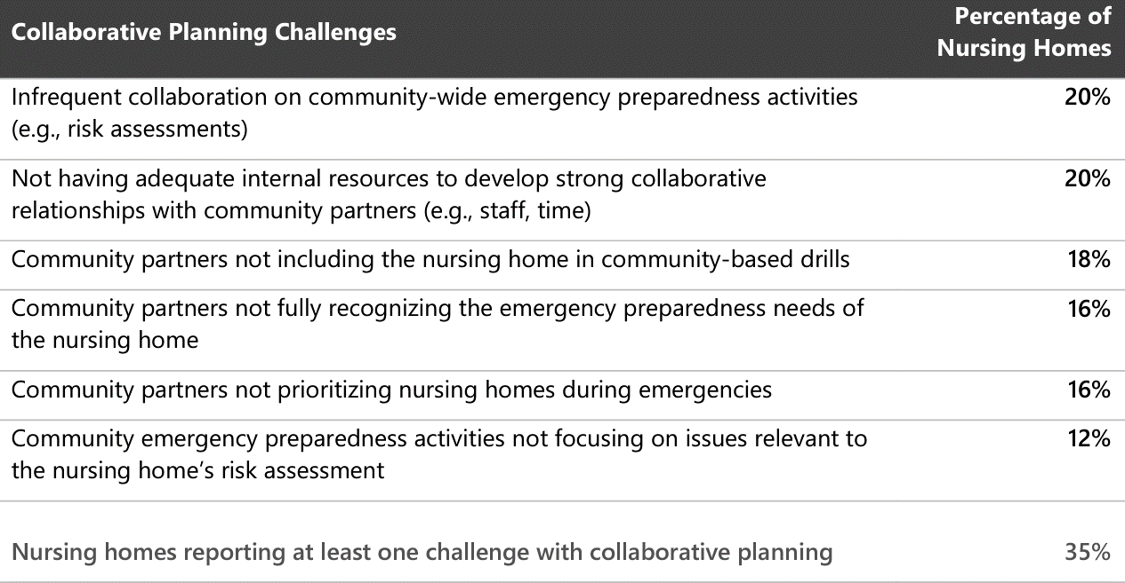
Collaborative Planning with Community Partners

Slide 23
Emergency Preparedness Plan
All-hazards approach: an integrated approach to emergency preparedness planning that focuses on capacities and capabilities that are critical to preparedness for a full spectrum of emergencies or disasters

Slide 24
Case Study

Slide 25
Case Study (cont.)
Flooding has been identified as a threat risk during a rural nursing home’s most recent hazard vulnerability assessment
Emergency preparedness exercises have occurred but only infrequently; due to staffing shortages, day-to-day operations have been priority
Recent heavy rainfall has created an increasingly emergent situation; the nursing home has reached out to their local emergency management agency to determine if and when evacuation would be needed
Flood waters have exceeded barriers overnight and alerts have been sent out through the community
Nursing home staff cannot find the emergency preparedness plan and have elected to call 911 to start evacuating residents
Local EMS response times will be longer than anticipated due to other community 911 calls
The Nursing Home Administrator called in additional staff to start transporting residents to the hospital by car
By the early morning, flood waters were no longer rising, however, roadways were damaged and critical supplies within the nursing home were dwindling
The Administrator located the emergency preparedness plan overnight and worked with the Director of Nursing to contact local authorities to access vital resources through contacts identified within the emergency preparedness plan
What went well?
Where are areas for improvement?
Where could we have made these improvements?

Slide 26
Collaborative Strategies for Building Resilience
Collaborative Planning Challenges | Potential solutions to build resilience
Inadequate internal resources to develop strong collaborative relationships with community partners (e.g., staff, time) | Leverage existing local meetings and events and be intentional about building relationships to streamline collaboration efforts across multiple priority areas, not just EPP
Infrequent collaboration on community-wide emergency preparedness activities | Call on QIO, local emergency volunteer agencies, and other local convening partners to help engage and lead partners to establish community-wide goals and shared vision with a regular cadence of meetings
Community partners not including the nursing home in community-based drills | Make specific requests via 1:1s to be included in community-based efforts while also inviting partners and hosting
Community partners not fully recognizing the emergency preparedness needs of the nursing home | Conduct outreach and education efforts to raise awareness with community partners about emergency preparedness needs of nursing homes. Share data and insights from nursing home assessments and emergency plans to inform community-wide planning efforts
Community partners not prioritizing nursing homes during emergencies | Establish and maintain strong relationships with key partners to ensure nursing homes are prioritized and adequately supported during emergencies; ensure commitments have been made and document agreements and action steps
Community emergency preparedness activities not focusing on issues relevant to the nursing home’s risk assessment | Partner with community organizations and local QIO to identify, access, and use targeted resources and tools that address nursing home-specific emergency preparedness needs

Slide 27
Success Stories

Slide 28
Success Story
Telligen hosted a collaborative event featuring lessons learned from nursing home leaders with lived experience
Colorado Marshall fire
Illinois tornadoes
Oklahoma wildfires
Introduced and promoted Telligen's EPP readiness assessment tool
19 nursing home leaders immediately completed the EPP assessment
94% of respondents said they identified opportunities to improvement their current EPP as a result of the session
“I learned that proper prior planning is essential to having a thorough EPP, and that practice can help staff remain calm during the real thing.”
- Nursing Home Participant

Slide 29
Success Story (cont.)
On Dec. 30, 2021, the Marshall Fire swept through Boulder County, destroying and damaging more than 1,000 homes and over 30 commercial structures
Most destructive fire in Colorado history
Telligen actively reached out to offer 1:1 support to affected nursing homes
Telligen and partners (CHCA and LeadingAge-CO) recognized healthcare heroes in 11 healthcare facilities, including hospitals, skilled nursing, and assisted living through Certificates of Valor

Slide 30
Key Takeaways and Action Steps
KEY TAKEAWAYS |  | ACTION STEPS
Completing a gap analysis and acting upon the findings results in a more comprehensive emergency preparedness plan |  | Apply the insights gained from this presentation to assess and improve emergency preparedness plans within your organization. QIOs and HQICs are here to help!
Review challenges and barriers faced by nursing homes in preparing for public health emergencies and natural and man-made disasters |  | Foster a culture of continuous improvement by regularly evaluating and updating emergency preparedness plans in response to evolving threats, lessons learned from past emergencies, and changes in regulations or guidelines Encourage feedback and participation from partners to drive ongoing improvements in preparedness efforts
Advance planning and numerous best practices help foster a culture of readiness and resilience during an emergency |  | Implement promising practices and foster ongoing collaboration and communication to strengthen resiliency and readiness for future emergencies

Slide 31
Thank You!
We appreciate your participation and engagement in today's session. Together, we can make a difference in building resilient communities and safeguarding the well-being for all!
This material was prepared by Telligen, a Quality Innovation Network-Quality Improvement Organization, under contract with the Centers for Medicare & Medicaid Services (CMS), an agency of the U.S. Department of Health and Human Services (HHS). Views expressed in this material do not necessarily reflect the official views or policy of CMS or HHS, and any reference to a specific product or entity herein does not constitute endorsement of that product or entity by CMS or HHS. This material is for informational purposes only and does not constitute medical advice; it is not intended to be a substitute for professional medical advice, diagnosis or treatment. 12SOW-QIN-02/09/24-5230

