Slide 1
Tips for Nursing Homes to Achieve 100% on Influenza and Pneumonia Immunization Quality Measures
Facilitator: Nell Griffin, Telligen Sr. Quality Improvement Facilitator
12SOW-QIN-02/21/22-4340
Notes:
Hello and welcome to Tips for Nursing Homes to Achieve 100% on Influenza and Pneumonia Immunization Quality Measures

Slide 2
Objectives
Describe the federal regulation for influenza and pneumonia immunizations
Explain how the influenza and pneumonia quality measures (QMs) are calculated
Outline a strategy for achieving 100% for the long-stay (LS) influenza and pneumonia QMs
Notes:
The objectives for this presentation are to describe the federal regulation for influenza and pneumonia immunizations, explain how these quality measures are calculated and outline a strategy for achieving 100% for this long-stay (LS) QM. The Minimum Data Set commonly known as MDS is a powerful tool for implementing standardized assessment and for facilitating care management in nursing homes. This presentation will support efforts to accurately assess and code these two immunizations.

Slide 3
Achieve 100% on Your Influenza and Pneumonia Immunization QMs
Improve and sustain a strong process
Decrease the risk of receiving a deficiency tag
Ensure accurate Minimum Data Set (MDS) coding
Understand which residents are triggering to lower your QMs
Decrease memory reliance of vaccination status
Notes:
For some QMs a lower rate is better but for the influenza and pneumonia higher rates of 100% are desirable. 100% on your facility’s influenza and pneumonia QMs is achievable. This can be accomplished by improving and sustaining strong processes.
Reviewing your Minimum Data Set coding process to ensure accurate coding and that the process includes identifying which resident assessments are triggering to lower your QMs. The next step is to improve or eliminate the root causes for that resident’s assessment contributing to the lower rate. The MDS is a powerful tool for implementing standardized assessment and for facilitating care management in nursing homes.
Using tools and resources can decrease reliance on memory alone because humans forget.

Slide 4
Federal Regulation: Influenza and Pneumococcal Immunizations
Must:
Write policy and procedure, review and update annually
Educate resident and/or representative of benefits and side effects
Offer vaccines
Document education, offer and resident response
eCFR :: 42 CFR Part 483 Subpart B -- Requirements for Long Term Care Facilities
Notes:
: Federal Regulation, 483.80 Infection control details the requirements each nursing home must meet specific to immunizations. Nursing homes must have written policy and procedure for their immunization practices that are reviewed and updated at least annually. Nursing homes must educate their residents and/or resident representatives of the benefits and side effects, before offering the influenza and pneumonia vaccines. There must be documentation that education was completed, the vaccine was offered and the resident’s response.

Slide 5
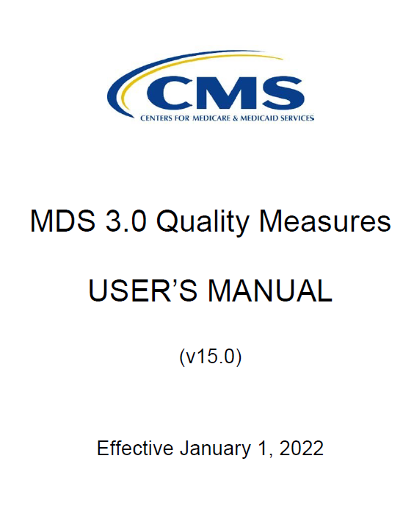
Valuable Tools
Minimum Data Set (MDS) 3.0 Resident Assessment Instrument (RAI) Manual | CMS
MDS 3.0 Quality Measures User's Manual | CMS
Notes:
Tools and resources help professionals meet expectations and decrease the likelihood of process failures. The RAI manual and the QM users guides are valuable for strong MDS coding processes. These are CMS released and periodically updated as needed.

Slide 6
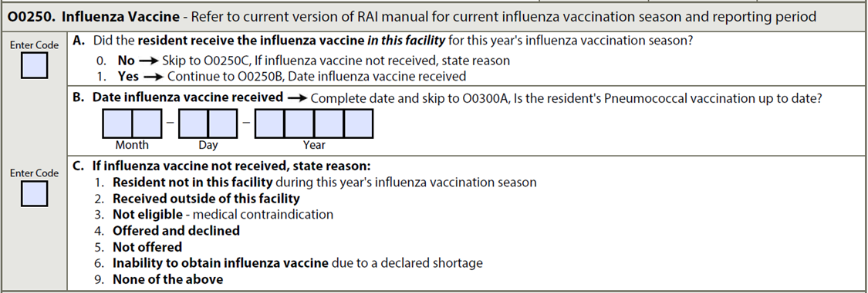

Influenza Immunization QM Overview
0
https://cmda.us/event-4157622
Coding 5, 6 and 9 will decrease the influenza immunization QM
(Note: Immunizations need to be offered October 1 through March 31)
Notes:
The influenza QM is credited for each resident you code as yes that the vaccine was administered and the date it was administered is entered. Both, yes and the date must be entered. The QM is still credited if a code for ‘no’ is entered but only if reasons 1-3 are also coded, 1, the resident was not in your facility during the influenza vaccination season, 2 the resident was vaccinated elsewhere, outside of your facility, 3 the resident has medical reasons for not taking the vaccine, or if you offered the vaccine but the resident declined the offer. However, if ‘no’ is coded and reasons 5, 6 or 9 are also coded, the QM is lowered. If ‘no’ is coded for reason 5 the vaccine was not offered, reason 6 inability to obtain the vaccine because of a shortage or if reason 9, none of these reasons apply, then the resident’s assessment will reduce this rate. Nursing homes are encouraged to investigate and submit corrected assessments when possible, anytime the reasons selected for the ‘no’ code are 5, 6 or 9.
It’s critical to know that this measure is only calculated once per 12-month influenza season and that each influenza season begins on July 1 of a given year and ends on June 30 of the following year. However, the target period used for calculating the influenza QM is the timeframe for which nursing homes are required to offer each resident an influenza immunization which begins on October 1 of each year through March 31 of the following year. The MDS assessments used to calculate the rate each season are the assessments submitted by each CMS certified facility for residents who were in the facility at least one day during the target period of October 1 through March 31 as written in the Requirements for Long Term Care Facilities to participate in the Medicare and Medicaid.

Slide 7
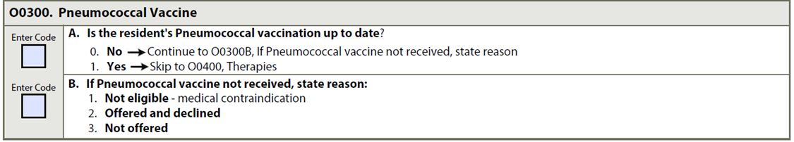
Pneumonia Immunization QM Overview
0
3
https://cmda.us/event-4157622
Coding 3 will decrease the pneumonia immunization QM
Notes:
The pneumonia QM is credited if coded yes that the resident’s pneumococcal vaccination is up to date. This QM is still credited when coded no, if the reason is coded 1 not eligible or 2 offered and declined. For the pneumonia QM, the only code that decrease this QM is if no is coded and the reason is the vaccine was not offered. The pneumonia immunization should be offered if it is medically appropriate and the resident is eligible all year long.

Slide 8
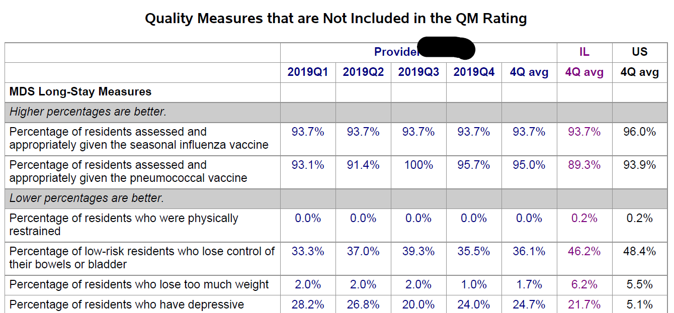
Review Your QM Performance
With your QAA/QAPI teams, review the following:
Internal EHR tracking
Nursing Home Compare Five-Star Provider Rating Report
Quality Improvement and Evaluation System (QIES)/CASPER Reporting – MDS 3.0 QM Resident Preview Report (found in My Inbox)
Example: Five-Star Provider Rating Report
Notes:
A function of the QAA committee and the QAPI steering team is data review and analysis. It’s a good practice to include the MDS coding process on the agenda for these meetings and to regularly review, analysis and act on the results of the data analysis such as your internal EHR, your CASPER data and your Nursing Home Compare Five-Star Provider Rating Report. The provider rating reports are sent to each CMS certified nursing home every month before the data is publicly posted on the Care Compare 5 star website.

Slide 9
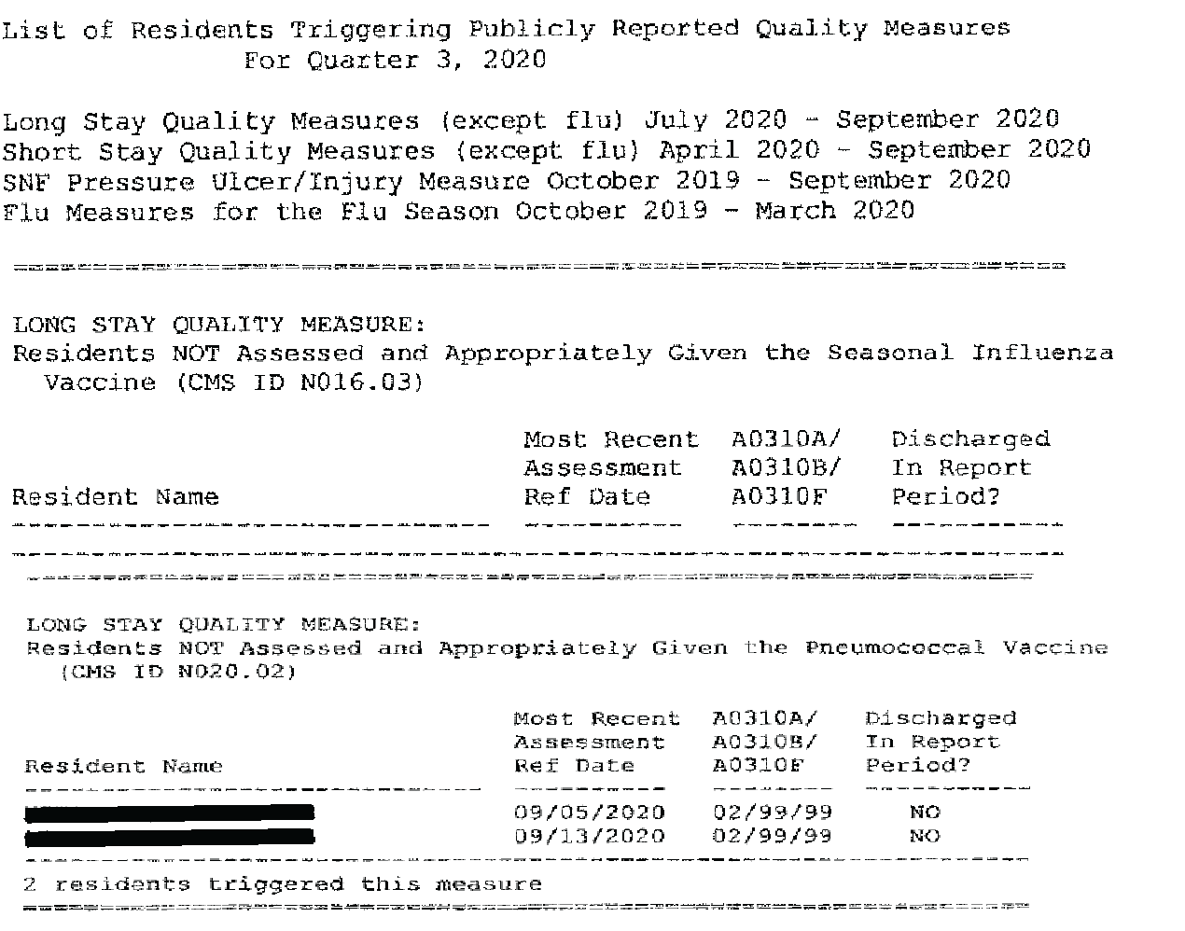
Review Your QM Performance
Access the Centers for Medicare & Medicaid Services (CMS) Quality Improvement and Evaluation System (QIES) for providers
Select folders and review “My Inbox”
Select List of Residents Triggering Publicly Reported QMs
Notes:
The monthly provider report is a data sources nursing homes are encouraged to download and review each month. Some EHRs download the report for the nursing homes but all nursing homes MDS coordinators should have access to the Centers for Medicare & Medicaid Services (CMS) Quality Improvement and Evaluation System known as (QIES). Each CMS certified nursing homes has an in box in this system. This report identifies the resident assessments that are triggering and lowering the influenza and pneumonia QMs. The provider report will support efforts to achieve 100% on these two QMs.

Slide 10

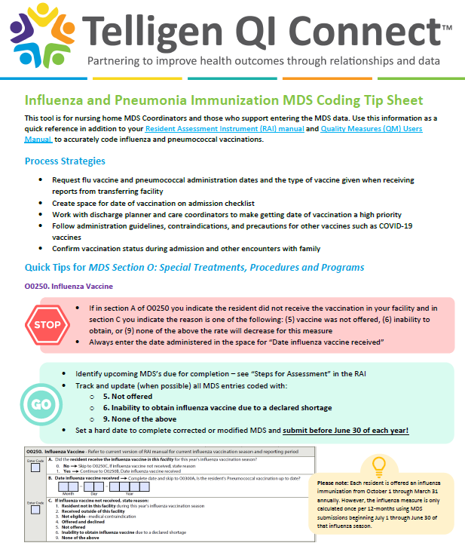
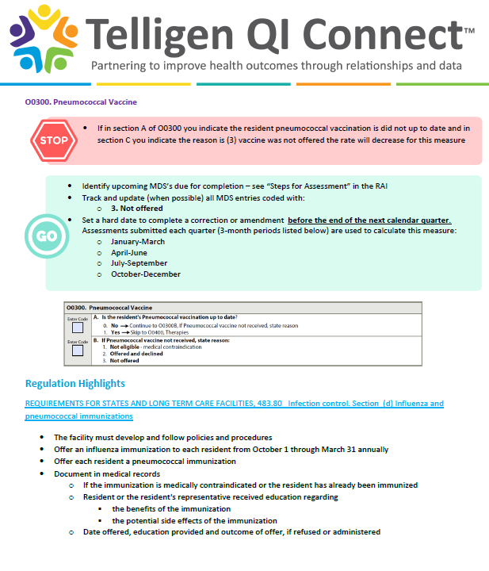

MDS Tip Sheet
https://cmda.us/event-4157622
Click here to download this resource.
Notes:
The tips presented in this presentation are available on a Telligen resource posted on the Telligen QI Connect website. This Influenza and Pneumonia Immunization MDS Coding Tip Sheet can be downloaded and used by any person involved in MDS coding of these measures.

Slide 11
Action Plan
Confirm you have a written policy and procedure, review and update annually
Explore your facility’s data:
  Are you less than 100%?
  Identify residents for coding that decreases your influenza and pneumonia QMs
Confirm:
  Education on the benefits and side effects
  Offering of each vaccine
  Documentation of the education, offering and resident response
Submit MDS:
  For influenza: before the end of the reporting period (March 31) for all eligible residents
  For pneumonia: update at next resident MDS due date
Notes:
To convert this information into knowledge and skill, practice is needed. Actions steps to support efforts to achieve and sustain 100% on the influenza and pneumonia QM are to confirm the immunization policy and procedures are current and reviewed and updated annually, that all staff who should know this policy and procedures do know. Include the immunization data in the data that the QAA committee and/or the QAPI team regularly analyze. Review the infection control regulation and confirm your practices include education on the benefits and side effect of the vaccines, the vaccine is offered to each resident and that you have strong documentation processes.
Confirm appropriately coded MDS influenza assessment has been submitted for all residents who were in your facility for at least one day during the target period of October 1 through March 31. The influenza measure is only calculated once per 12-month influenza season. Confirm the pneumonia vaccine is offered and appropriately coded on the MDS submission for all eligible residents.

Slide 12
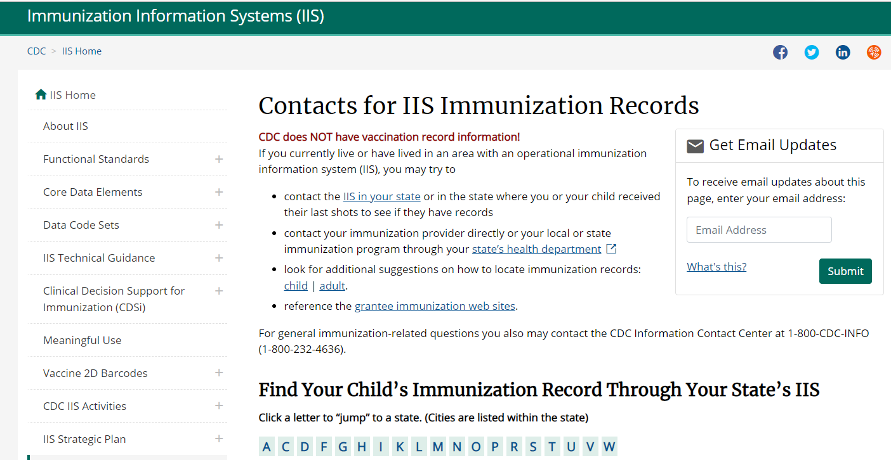
A Resource Nursing Homes Can Share!
Help staff, residents and families get the immunization information you need
CDC website provides link to each state’s Immunization Information System (IIS)
Individuals can register with the IIS in their state and download their immunization records
https://www.cdc.gov/vaccines/programs/iis/contacts-locate-records.html#state
Notes:
You can help residents and their families help you get their immunization by providing them with the information to access the immunization information system known as IIS. Encouraging residents and or their family representatives to register and access this website is a strategy for getting resident vaccination data.

Slide 13
Resources
Vaccines and Preventable Diseases: http://www.cdc.gov/vaccines/vpd-vac/default.htm
Vaccine Safety Monitoring and Vaccine Safety Activities of the CDC: http://www.cdc.gov/vaccinesafety/ensuringsafety/monitoring/index.html
Pneumococcal Vaccine Timing for Adults: https://www.cdc.gov/vaccines/vpd/pneumo/downloads/pneumo-vaccine-timing.pdf
Adult Vaccination Resources: https://www.cdc.gov/vaccines/hcp/adults/for-practice/standards/referral.html
Vaccine Recommendations and Guidelines of the ACIP: Immunization Schedules and Vaccine Recommendations and Guidelines: https://www.cdc.gov/vaccines/schedules/hcp/index.html & http://www.cdc.gov/vaccines/hcp/acip-recs/index.html
Pneumococcal Disease: http://www.cdc.gov/pneumococcal
Influenza (Flu): http://www.cdc.gov/flu/
Notes:
Here is a list of the resources used to create this presentation and that can support your ongoing improvement and sustainment activities.

Slide 14
Contact Us
Telligen Nursing Home Team | nursinghome@telligen.com
Telligen QI Connect https://www.telligenqiconnect.com
Notes:
Contact the Telligen nursing home team at nursinghome@telligen.com if you have questions or want to meet with a facilitator. Visit the Telligen QI Connect website anytime for tools, resources and to register for events.

